Slide 2
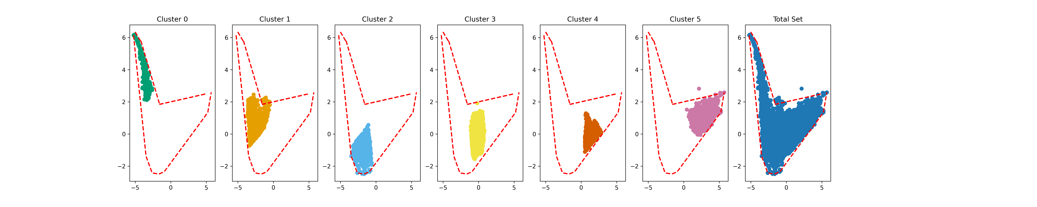
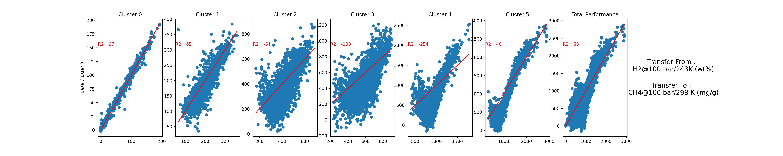

Analysis of Transfer to CH₄ at 298 K
(Base Cluster 0)

Slide 3
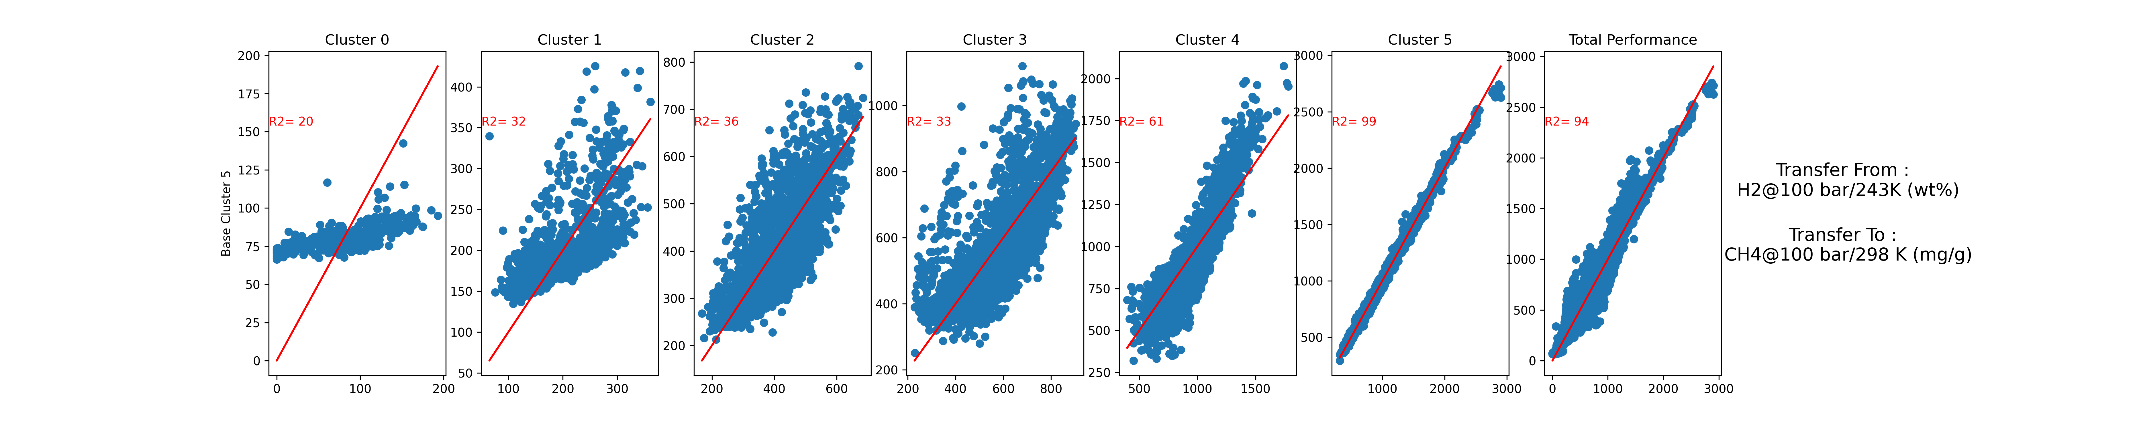

Analysis of Transfer to CH₄ at 298 K
(Base Cluster 5)

Slide 4
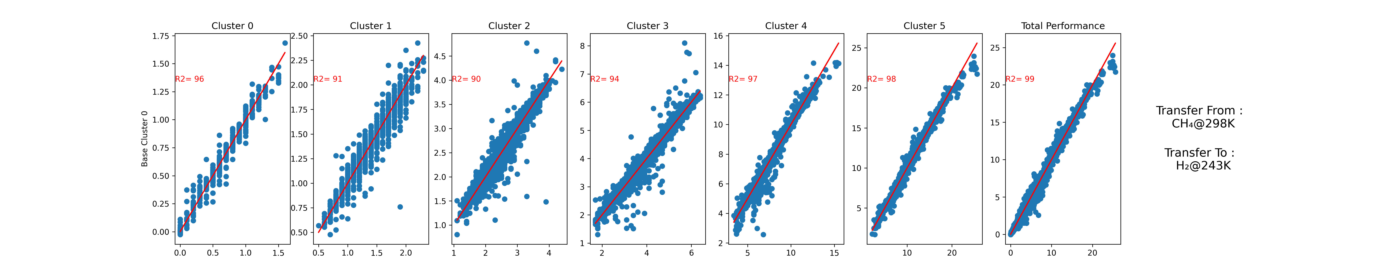
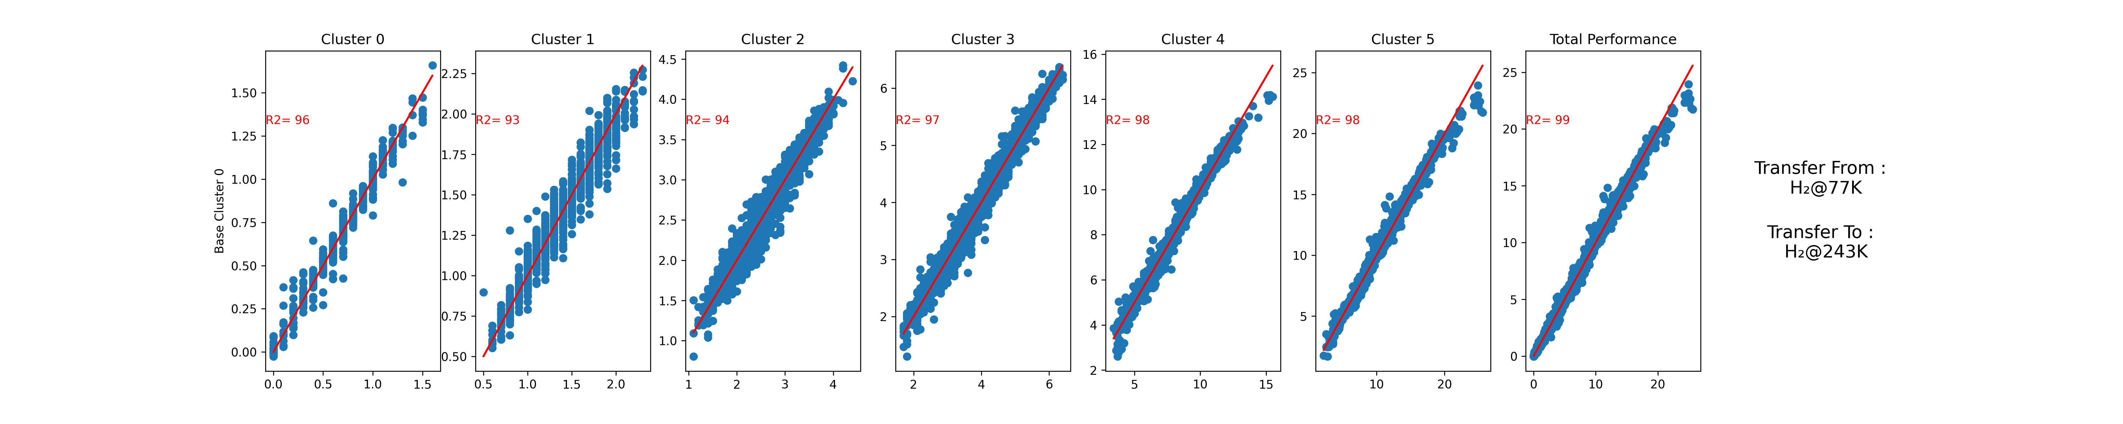
Analysis of Transfer to H₂ at 298 K
(Base Cluster 0)

Slide 5
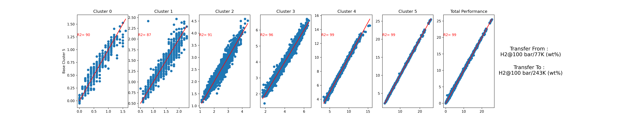
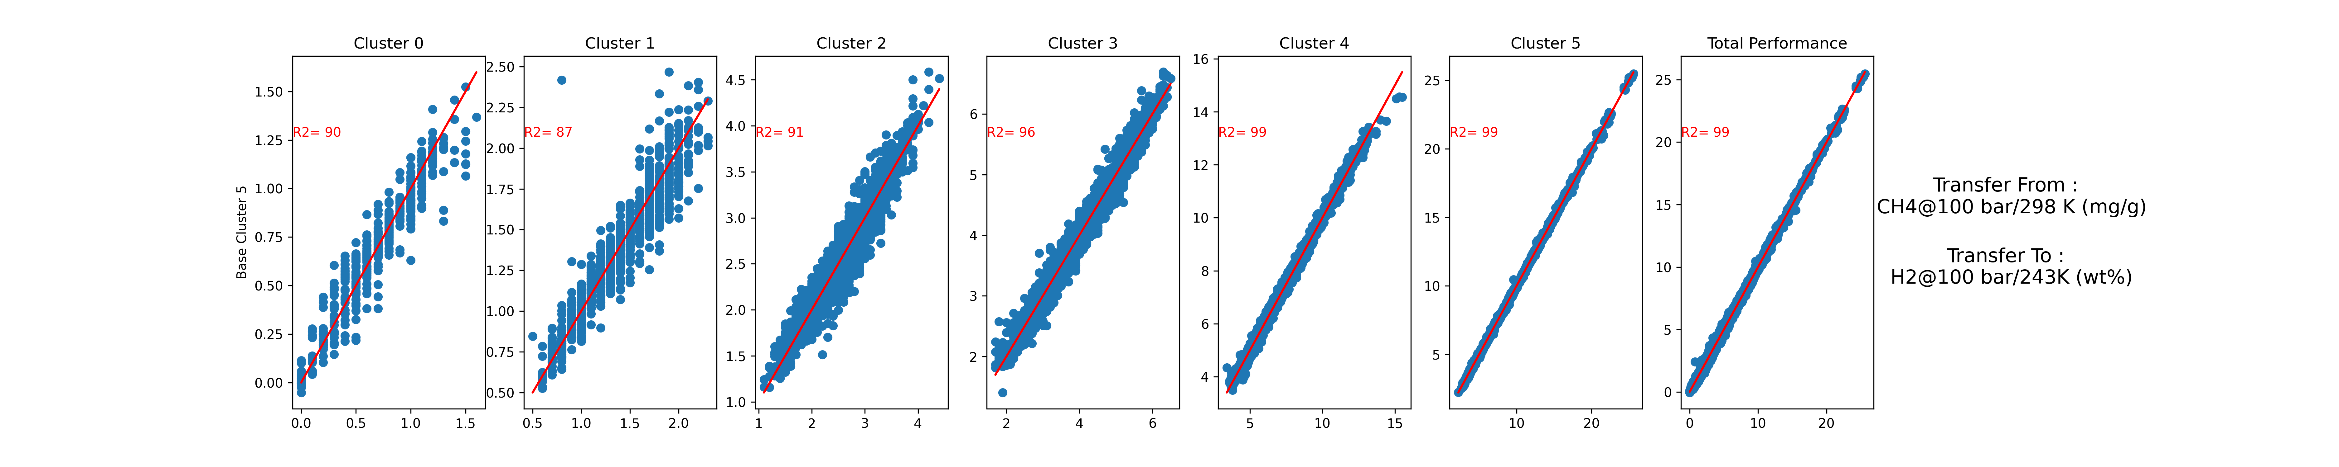
Analysis of Transfer to H₂ at 298 K
(Base Cluster 5)

